Slide 1
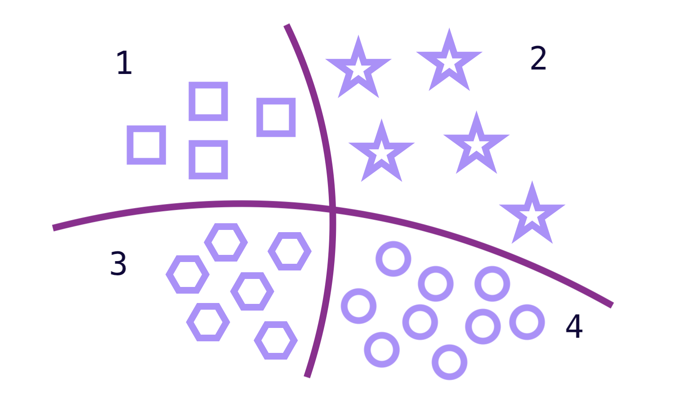
Multi-class Classification

Slide 2
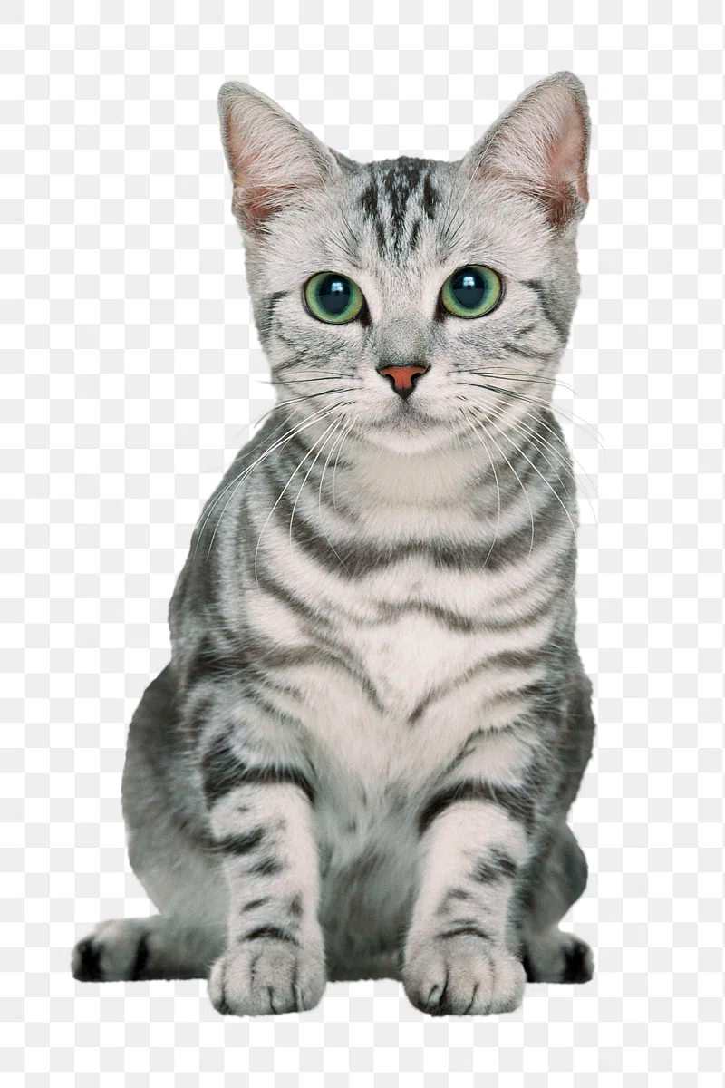



Cat - Dog classification
Cat
Y = 0
Dog
Y = 1
Cat
Y = 0
Dog
Y =1
We can use also the sigmoid function

Slide 3
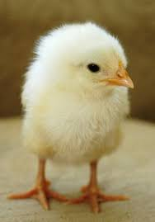
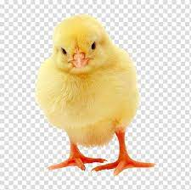
What about this ?!
Cat
Y = 0
Baby chicken
Y = 2
Dog
Y = 1
Cat
Y = 0
Baby chicken
Y = 2
Dog
Y =1

Slide 4
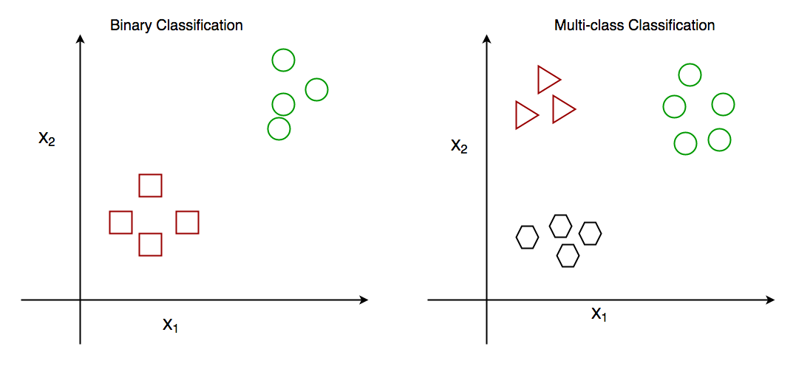

Slide 5


Slide 6
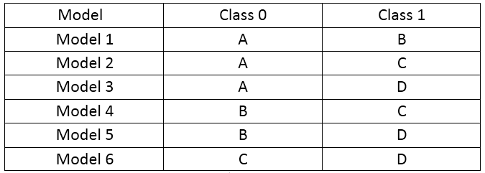

Slide 7
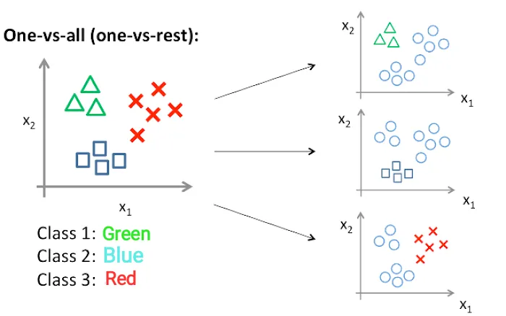
One-vs-all (one-vs-rest)

Slide 8
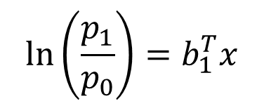
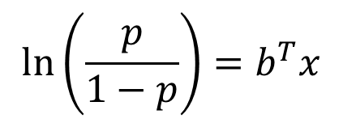
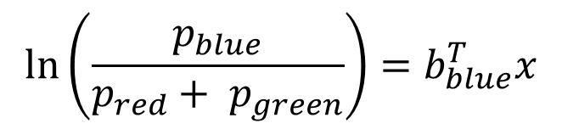
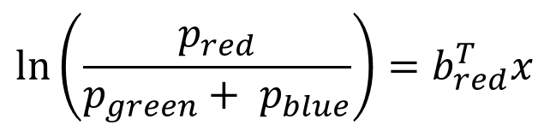
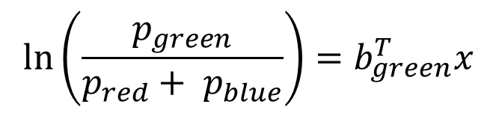
One-vs-all (one-vs-rest)
$$\ln\left(\frac{p}{1−p}\right)=b^{T}x$$
$$\ln\left(\frac{p_{1}}{p_{0}}\right)=b_{1}^{T}x$$
$$\ln\left(\frac{p_{green}}{p_{red}+ p_{blue}}\right)=b_{green}^{T}x$$
$$\ln\left(\frac{p_{red}}{p_{green}+ p_{blue}}\right)=b_{red}^{T}x$$
$$\ln\left(\frac{p_{blue}}{p_{red}+ p_{green}}\right)=b_{blue}^{T}x$$

Slide 9
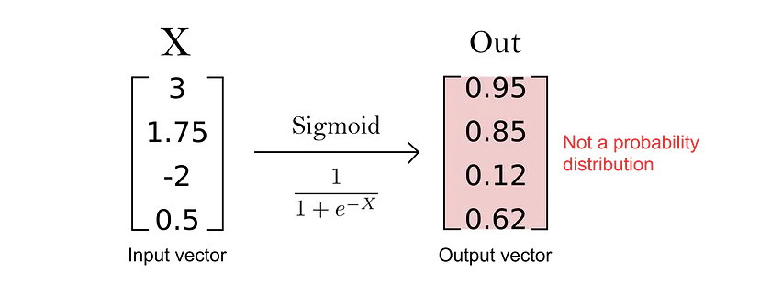
The output is not a probability distribution because there no relationship between them (because the denominator is variable). So we can’t apply sigmoid

Slide 10
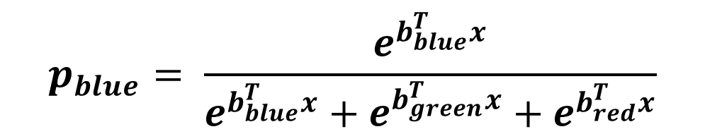
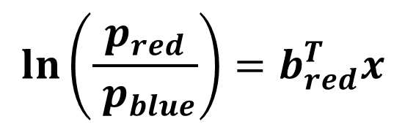
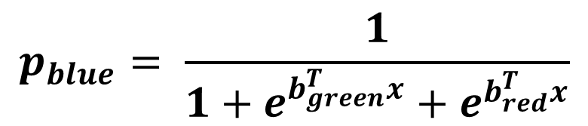

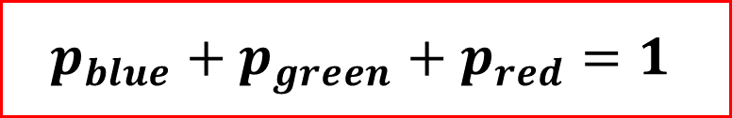
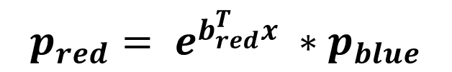
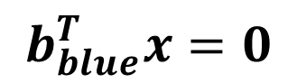
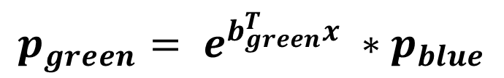
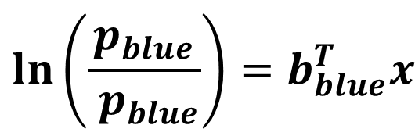
So, we will choose one class to be our pivot class
$$\ln\left(\frac{p_{blue}}{ p_{blue}}\right)=b_{blue}^{T}x$$
$$\ln\left(\frac{p_{green}}{p_{blue}}\right)=b_{green}^{T}x$$
$$\ln\left(\frac{p_{red}}{ p_{blue}}\right)=b_{red}^{T}x$$
$$p_{green}= e^{b_{green}^{T}x} ∗p_{blue}$$
$$p_{red}= e^{b_{red}^{T}x} ∗p_{blue}$$
$$b_{blue}^{T}x=0$$
$$p_{blue}+p_{green}+p_{red}=1$$
$∴$ $p_{blue}+e^{b_{green}^{T}x} ∗p_{blue}+e^{b_{red}^{T}x} ∗p_{blue}=1$
$$p_{blue}= \frac{e^{b_{blue}^{T}x}}{e^{b_{blue}^{T}x}+e^{b_{green}^{T}x}+e^{b_{red}^{T}x}}$$
$$p_{blue}= \frac{1}{1+e^{b_{green}^{T}x}+e^{b_{red}^{T}x}}$$

Slide 11
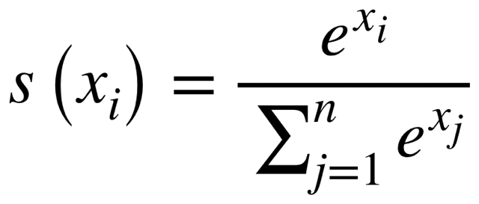
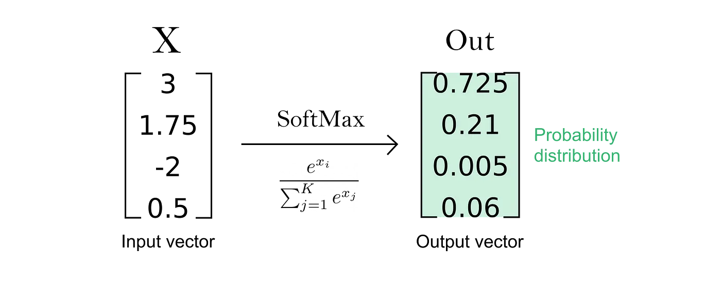
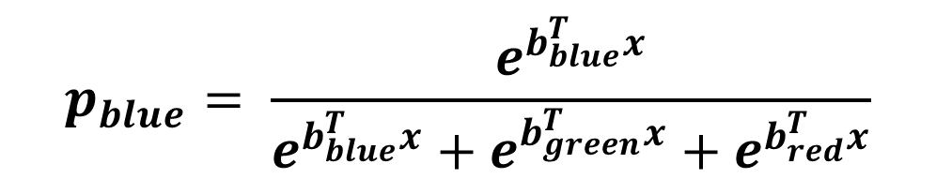
( Softmax function )
$$p_{blue}= \frac{e^{b_{blue}^{T}x}}{e^{b_{blue}^{T}x}+e^{b_{green}^{T}x}+e^{b_{red}^{T}x}}$$

Slide 12
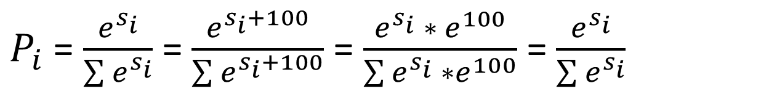
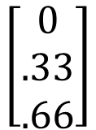
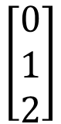
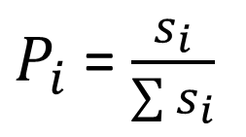
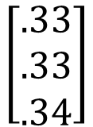
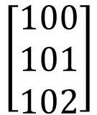
IDEA 1
x
p
x
p
$$\left[\begin{aligned}0 \\ 1 \\ 2\end{aligned}\right]$$
$$\left[\begin{aligned}0 \\ .33 \\ .66\end{aligned}\right]$$
$$\left[\begin{aligned}100 \\ 101 \\ 102\end{aligned}\right]$$
$$\left[\begin{aligned}.33 \\ .33 \\ .34\end{aligned}\right]$$
$P_{i}$ = $\frac{s_{i}}{\sum{s_{i}}}$
Which means if we add constant to all score ($b^{T}x+100 ) it changes the probailty$
IDEA 2
$P_{i}$ = $\frac{e^{s_{i}}}{\sum{e^{s_{i}}}}$ = $\frac{e^{s_{i}+100}}{\sum{e^{s_{i}+100}}}$ = $\frac{e^{s_{i}} ∗ e^{100}}{\sum{e^{s_{i}} ∗e^{100}}}$ = $\frac{e^{s_{i}}}{\sum{e^{s_{i}}}}$

Slide 13
Let’s derive the cost function

Slide 14
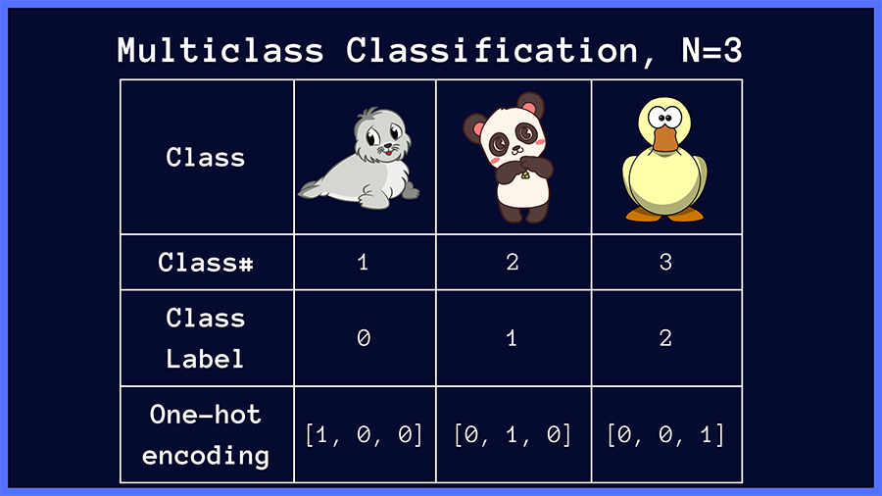

Slide 15
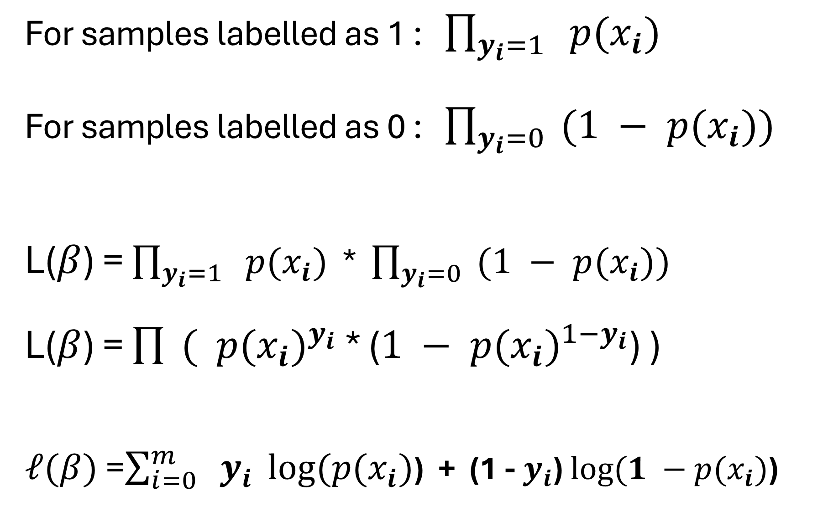
For samples labelled as 1 : $\prod_{y_{i}=1}{ p(x_{i})}$ For samples labelled as 0 : $\prod_{y_{i}=0}{ (1 − p(x_{i}))}$ L($β$) = $\prod_{y_{i}=1}{ p(x_{i})}$ * $\prod_{y_{i}=0}{ (1 − p(x_{i}))}$ L($β$) = $\prod{ ( {p(x_{i})}^{y_{i}}}$ * ($1 − {p(x_{i})}^{1−y_{i}}$) ) $ℓ(β)$ =$\sum_{i=0}^{m}{ y_{i}} log⁡(p(x_{i})$) + (1 - $y_{i}$) $log⁡(1 −p(x_{i})$)

Slide 16
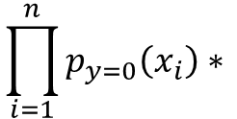
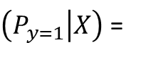
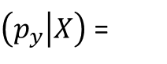
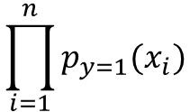
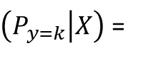
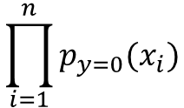
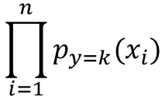
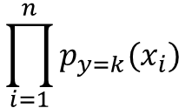
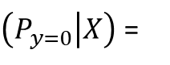
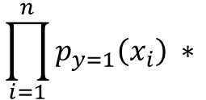
For samples labeled as 0:
$$\prod_{i=1}^{n}{p_{y=0}(x_{i})}$$
$\left(P_{y=0} | X\right)$ =
For samples labeled as 1:
$$\prod_{i=1}^{n}{p_{y=1}(x_{i})}$$
$\left(P_{y=1} | X\right)$ =
For samples labeled as k:
$$\prod_{i=1}^{n}{p_{y=k}(x_{i})}$$
$\left(P_{y=k} | X\right)$ =
$$\prod_{i=1}^{n}{p_{y=0}\left(x_{i}\right)∗ }$$
$$\prod_{i=1}^{n}{p_{y=1}\left(x_{i}\right) ∗ }$$
$$\prod_{i=1}^{n}{p_{y=k}(x_{i})}$$
$\left(p_{y} | X\right)$ =

Slide 17
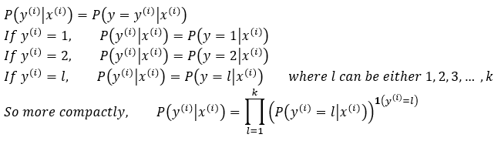
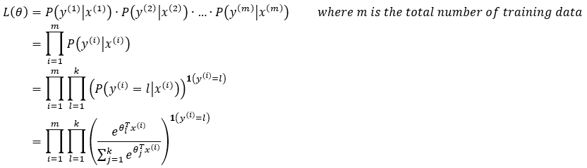

Slide 18
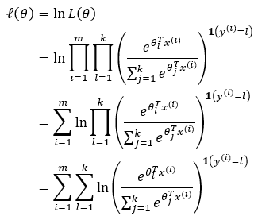
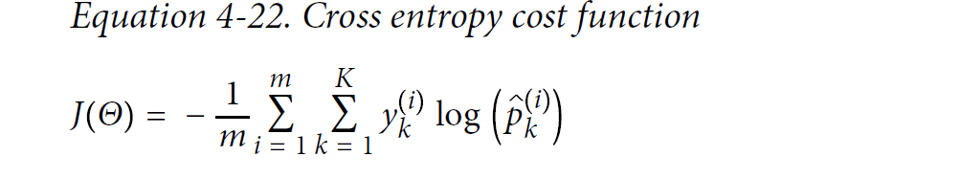

Slide 19
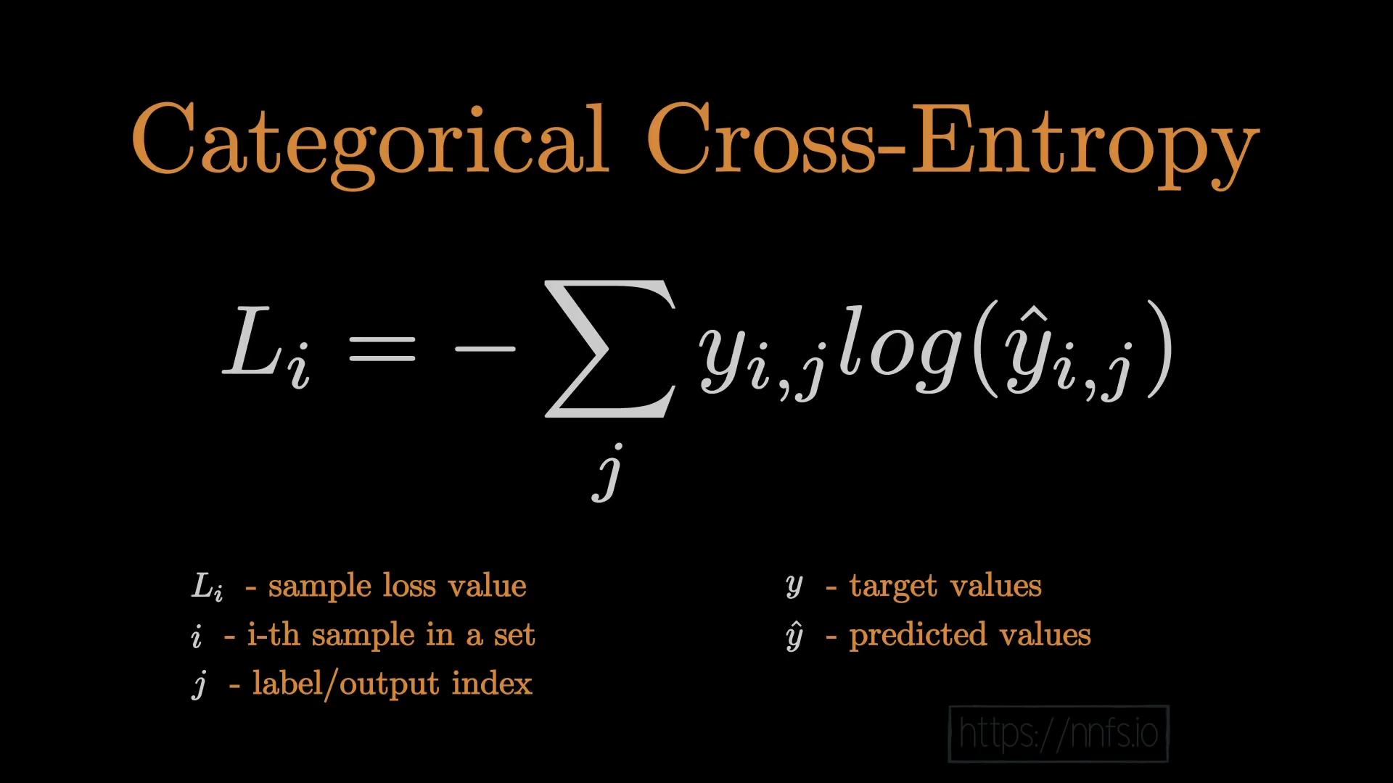

Slide 20
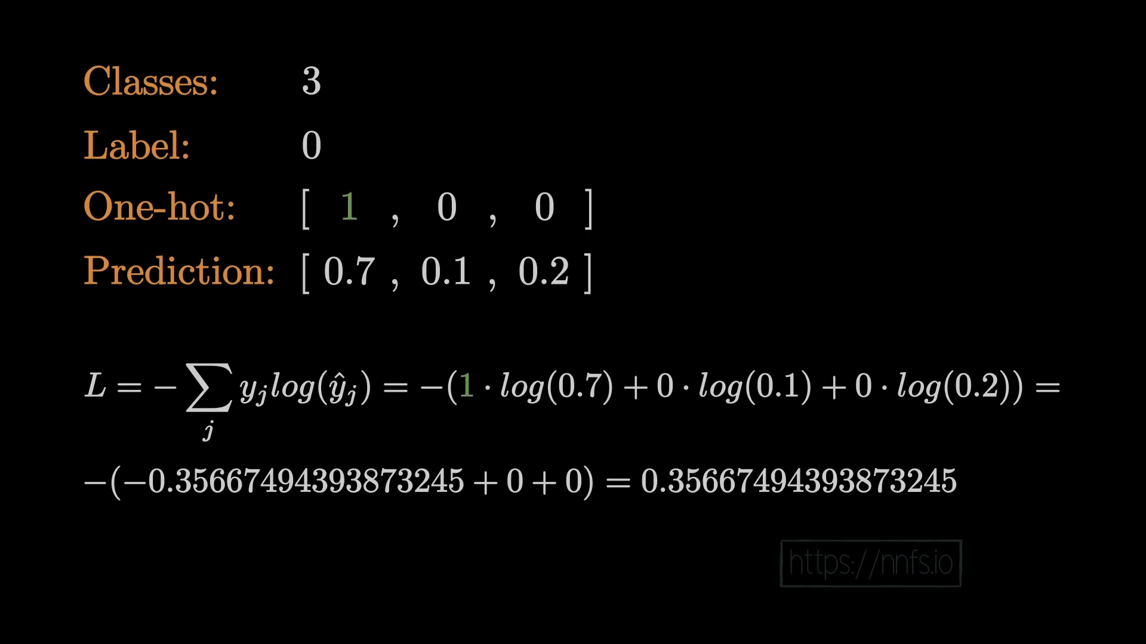

Slide 21
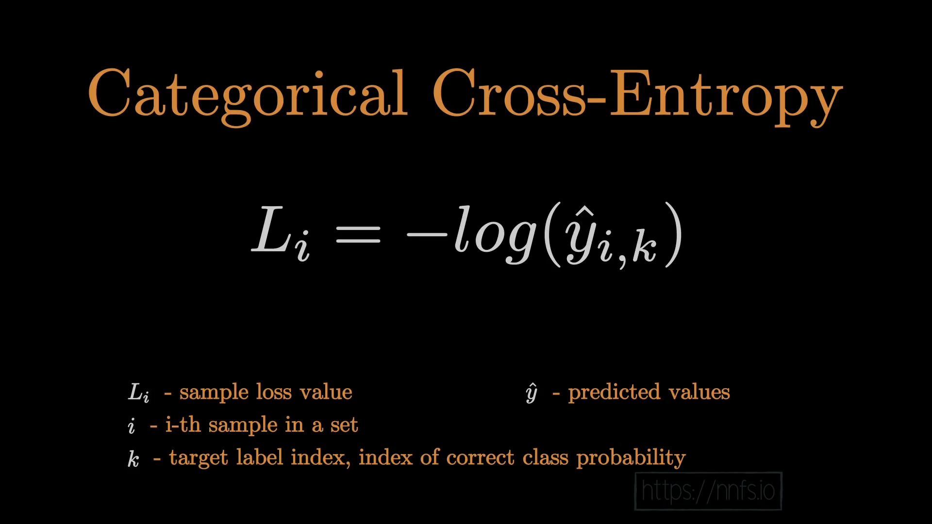

Slide 22
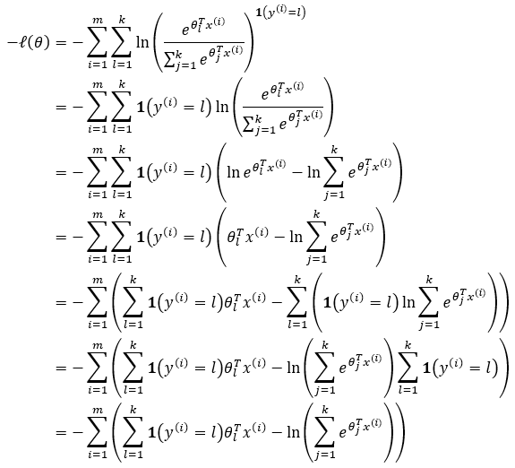


Slide 23




Slide 25


